Slide 1

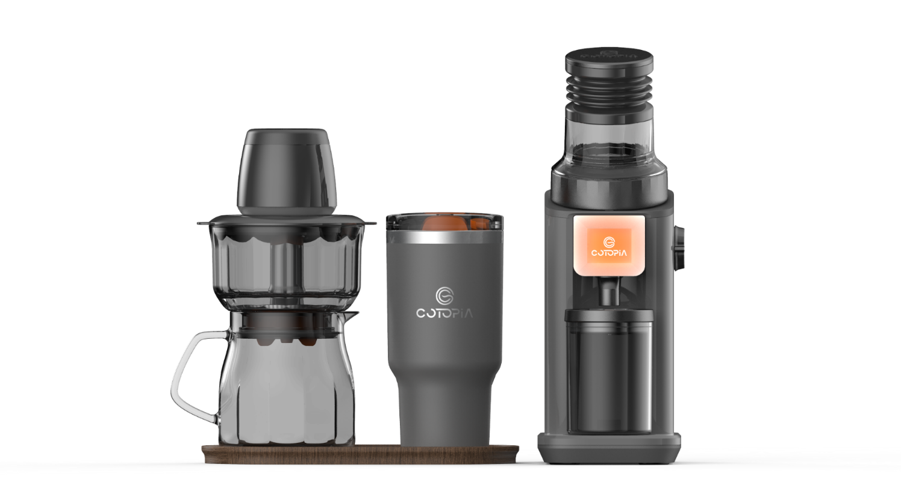

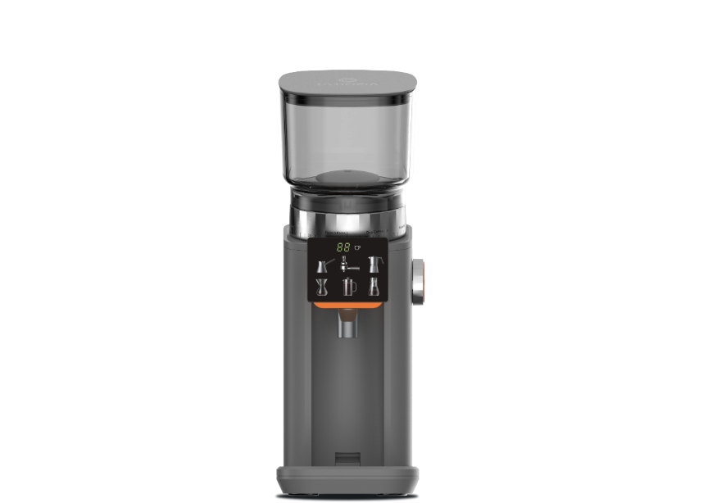
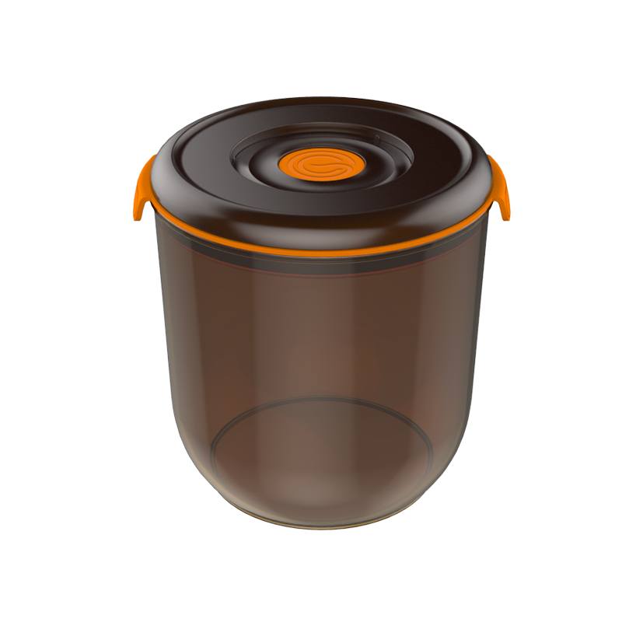



VacBrew
Revolutionizing Coffee Brewing with Innovative Vacuum Technology
Discover the future of coffee brewing with VacBrew, the ultimate solution for crafting both refreshing cold brew and rich, hot coffee in minutes and seconds.
Designed for coffee enthusiasts who value speed, flavor, and convenience, VacBrew transforms traditional brewing methods with its patented vacuum technology for fast and consistent results.
Whether you're at home, in the office, or on an adventure, VacBrew's portable design and versatile functionality ensure you enjoy barista-quality coffee anytime, anywhere.
From its durable TRITAN brewing chamber to its intuitive operation, VacBrew offers a seamless and satisfying coffee experience for every occasion. Redefine your coffee ritual with VacBrew—where innovation meets perfection.
Idea from Spain
Solutions for your Home

Slide 2

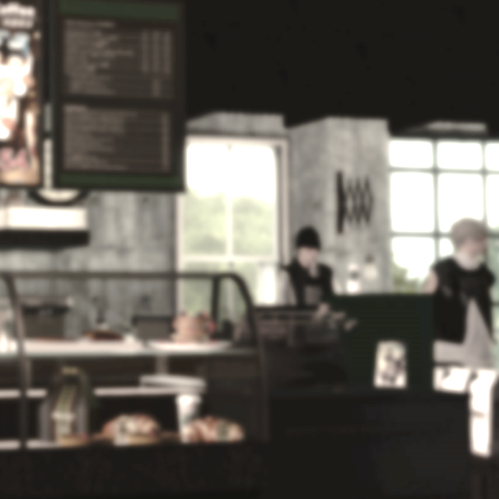
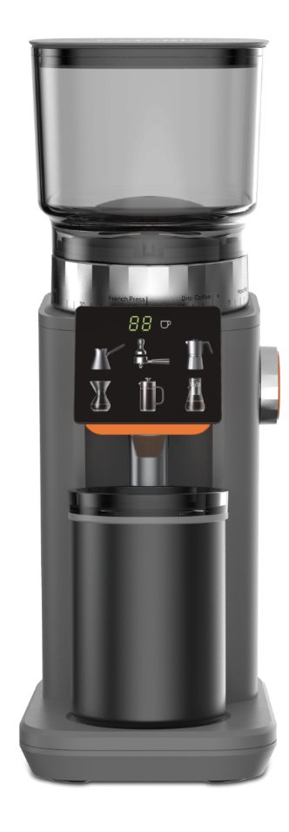
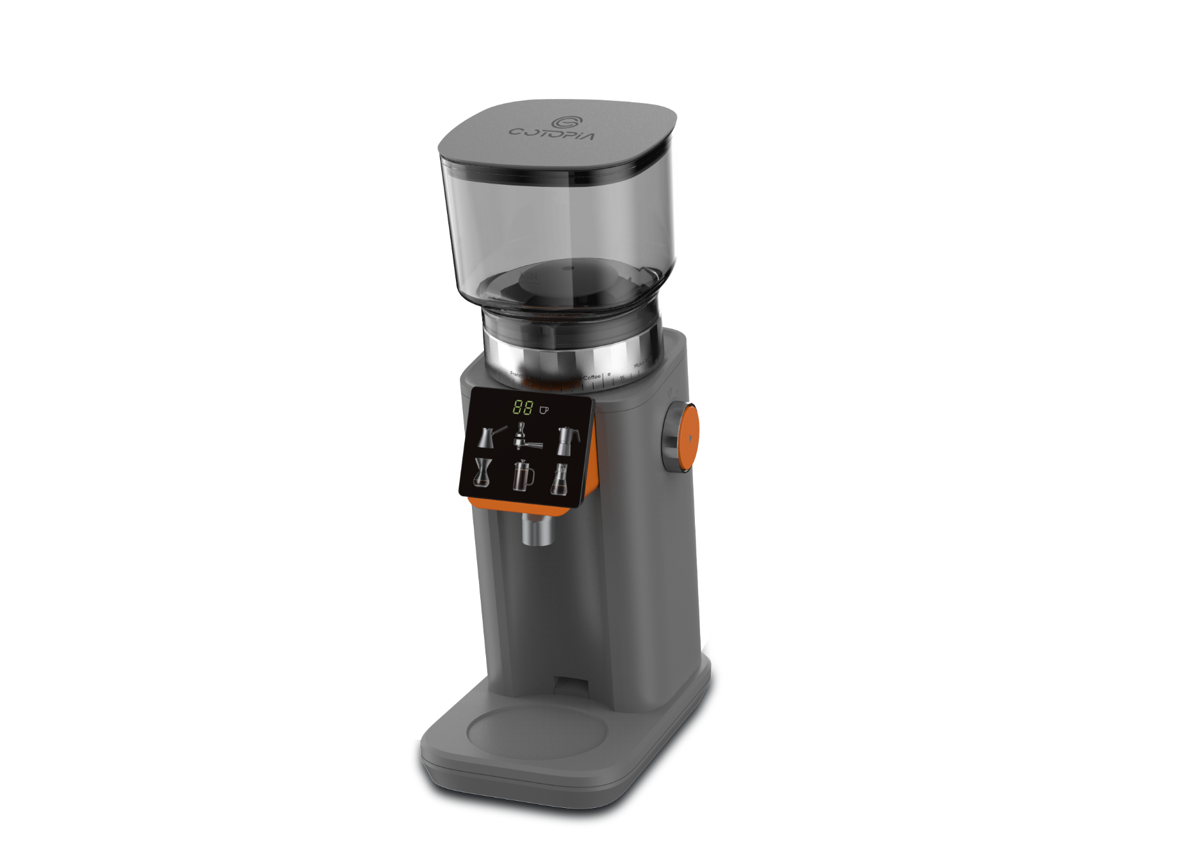


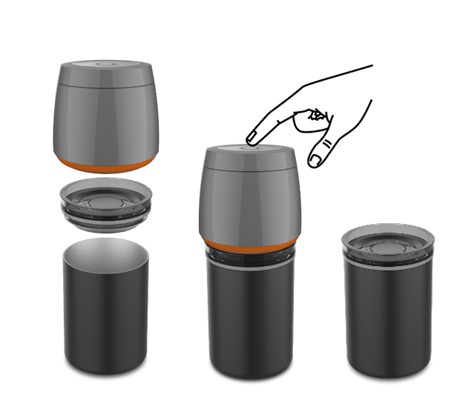

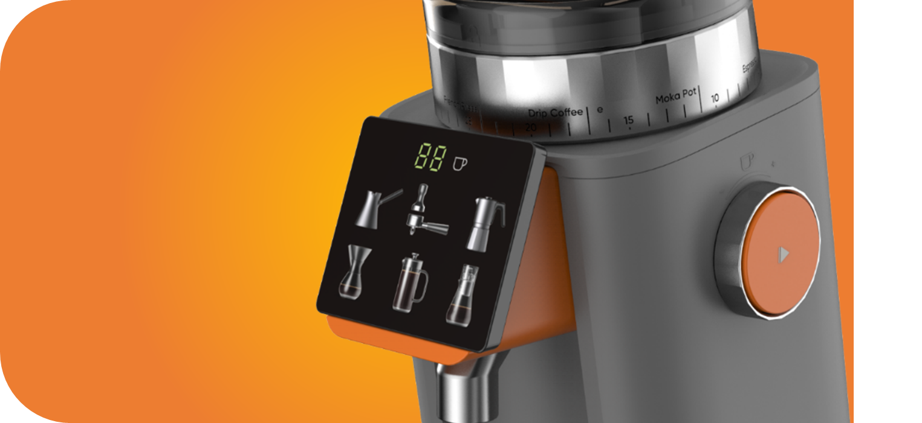
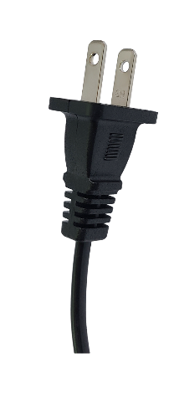
CG948#5
VacBrewith Smart AC Grinder with Grinding size Feedback System
RRP US$199
Patented
design
Vacuum
technology
Grind size
feedback system
Smart AC Grinder: Precision, Power, Perfection!
Smart Grinder with Feedback Display
An intelligent grinding system that visually guides your setting. The LED screen reflects every rotation of the dial, giving real-time precision from espresso to ultra-fine Turkish coffee.
Professional SUS detachable Burr Blades
Equipped with stainless-steel conical burrs that grind coffee evenly and consistently. Achieves ultra-fine texture down to 100μm, ideal for authentic Turkish-style brewing (with SGS testing certificate). Detachable for easy cleaning
Dual-Bearing Gearbox & Sensor Protection
Engineered with dual bearings and PCB sensors to ensure stability, safety, and durability—featuring both thermal and current protection.
Vacuum-Compatible Design
Smart cup comes with vacuum lid compatible with the VacBrew rechargeable pump for long-lasting coffee freshness & smell. (Pump not included.)
Package (GB)
LxWxH. 345x 315x 330mm
EAN Code.
Gross weight. 6.2kg
Net weight. kg
Carton
LxWxH. x x mm
EAN Code.
Gross weight. kg
Quantity
Per Carton. pcs
Per Pallet. pcs
Per Container 20ft. 1652pcs
Per Container 40ft. 3416pcs
Per Container 40HQ.3768pcs
Items included
Smart AC Grinder 1pc
Smart cup with VacLid 1pc
Removable Bean Hopper 1pc
Idea from Spain
Solutions for your Home

Slide 3
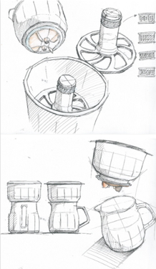
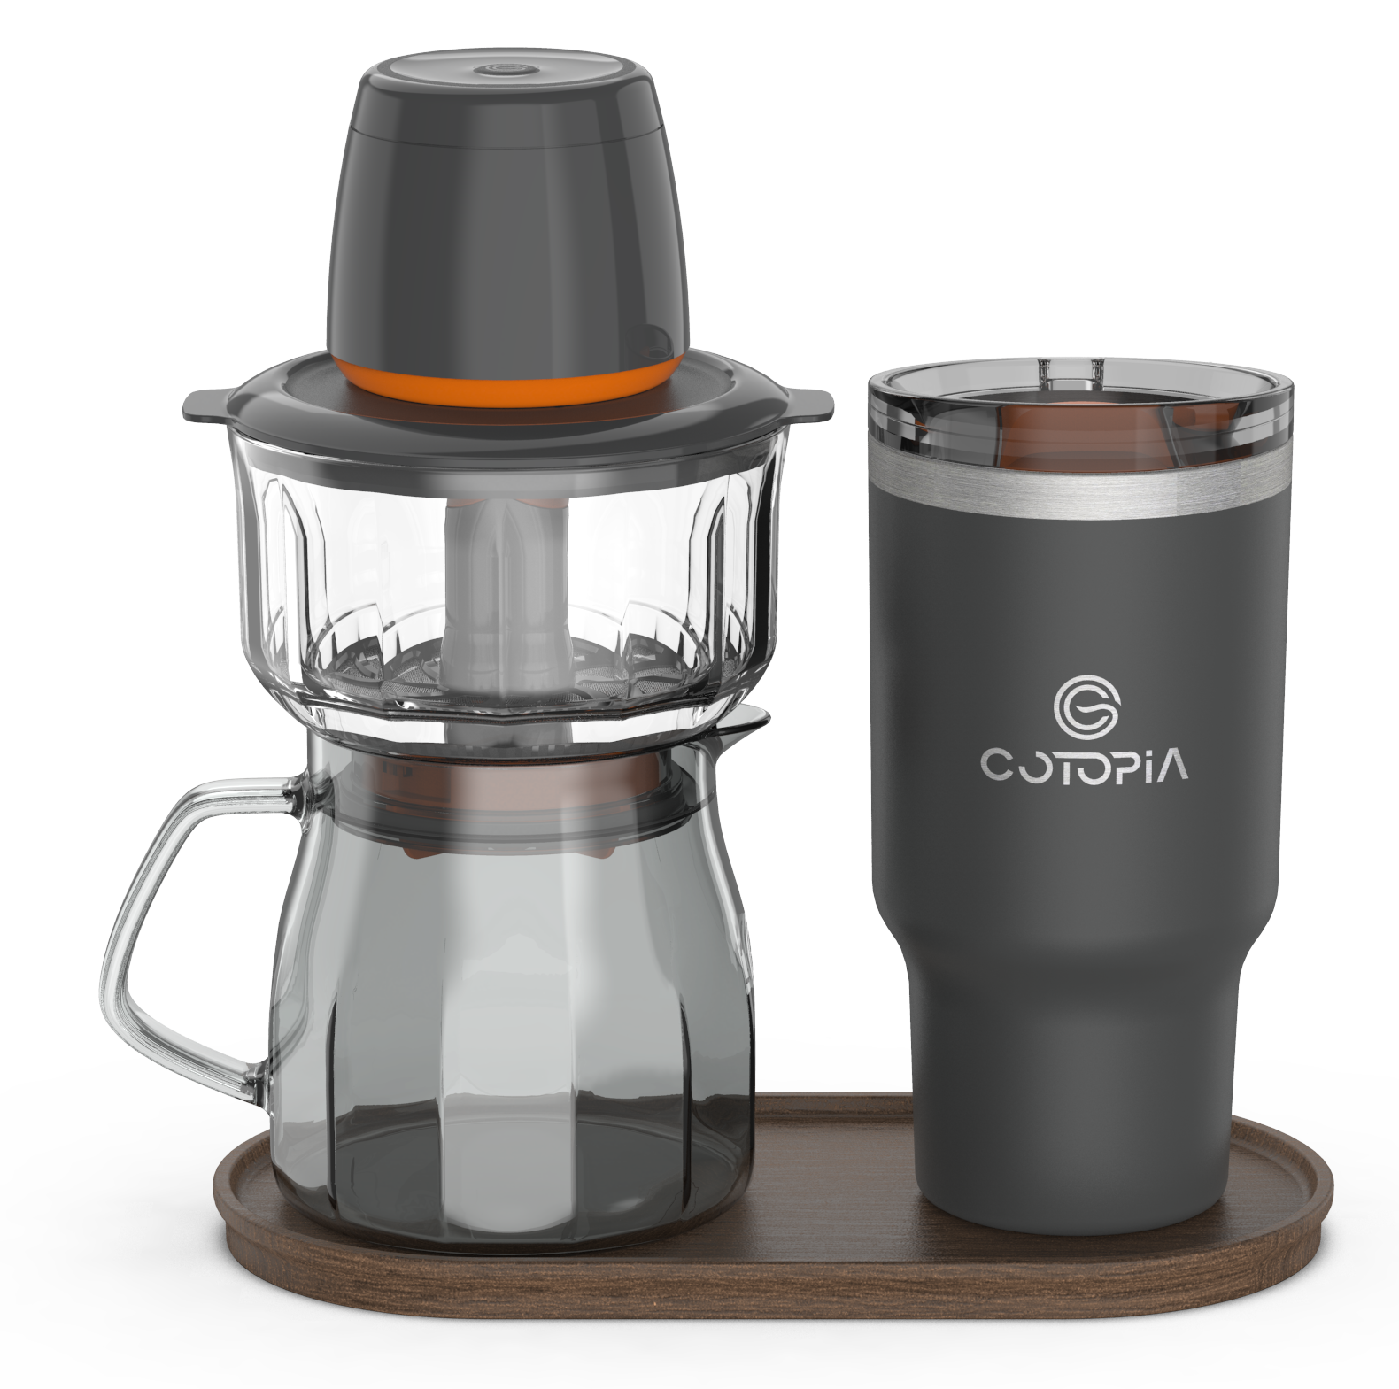




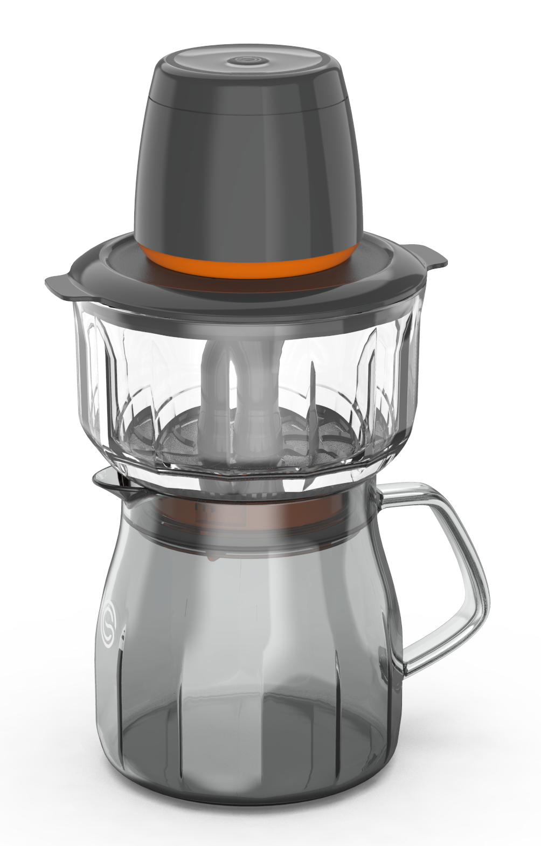
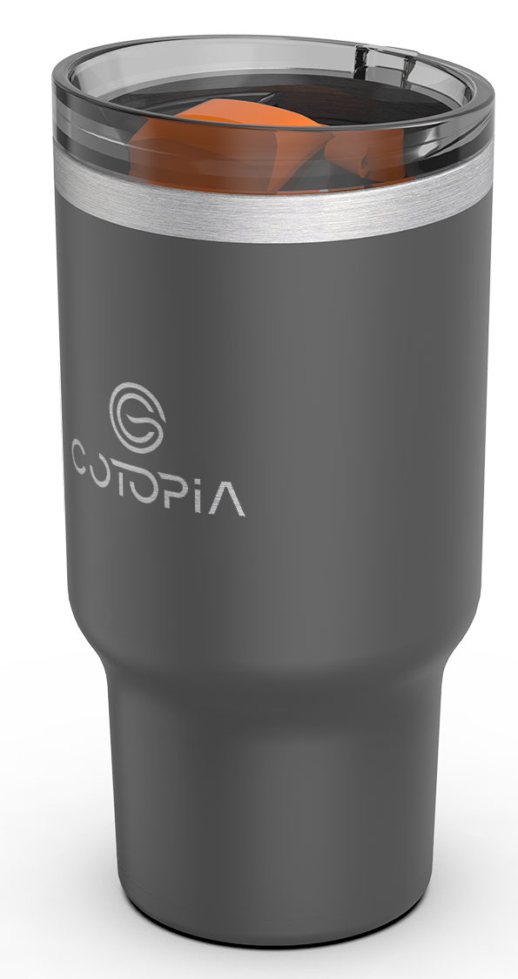
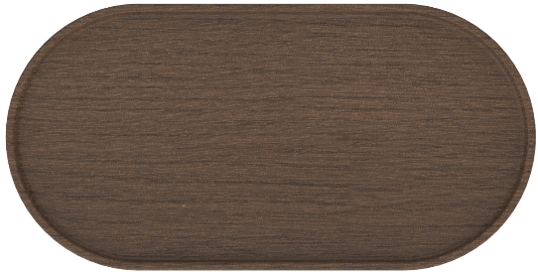
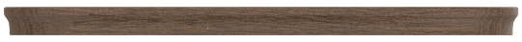
CT40000
VacBrew Premium Gift set
RRP US$159
Patented
design
Ice water for
Cold brew (5-12mins)
Vacuum
technology
<90C/203F water for
Hot brew (30s)
Type-C
Rechargeable
4 settings to tailor
For personal taste
VacBrew Premium Gift Set: The Ultimate Gift for Coffee Lovers
Enhance your coffee brewing experience with our Extra Brewing Set, perfect for serving friends and family or exploring a variety of coffee beans and flavors at the same time.
This additional brewing set allows you to prepare multiple brews effortlessly, whether you're hosting a gathering or experimenting with different coffee profiles.
Versatile and convenient, it’s also ideal for hot and cold tea brewing, offering the same precision and quality for tea enthusiasts.
Pair it with our vacuum pump rechargeable with timer to expand your brewing possibilities!
Package (GB)
LxWxH. x x mm
EAN Code.
Gross weight. kg
Net weight. kg
Carton
LxWxH. x x mm
EAN Code.
Gross weight. kg
Quantity
Per Carton. pcs
Per Pallet. pcs
Per Container 20ft. pcs
Per Container 40ft. pcs
Per Container 40HQ.pcs
100mm
104mm
204mm
81mm
Items included
Vacuum Turtle (pump) 1pc
Dual function Lid 1pc
Removable Filter 1pc
Removable Deflector 1set
Brewing chamber 500ml 1pc
Glass jar 600ml 1pc
SUS Coffee Mug 960ml 1pc
Stirrer 1pc
Cherry Wood tray 1pc
119mm
75mm
136
15
270
Idea from Spain
Solutions for your Home

Slide 4
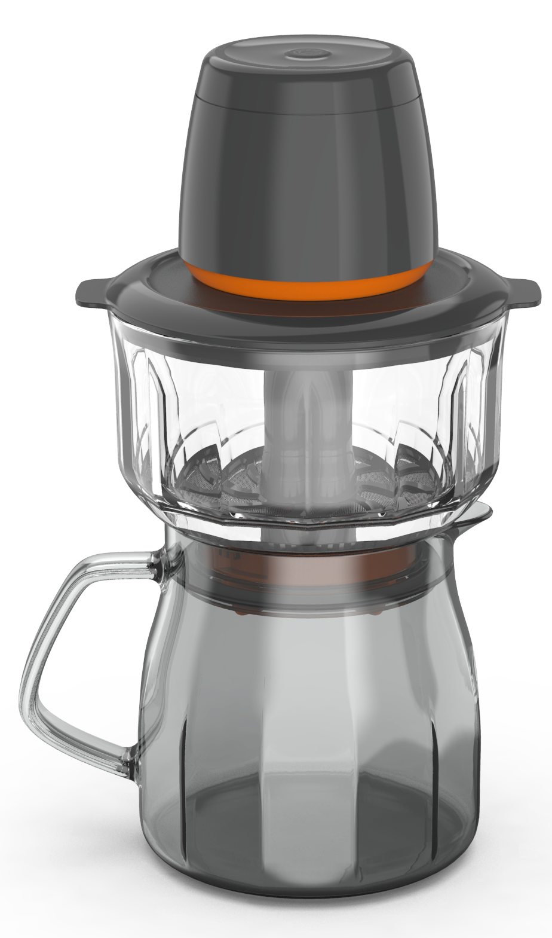
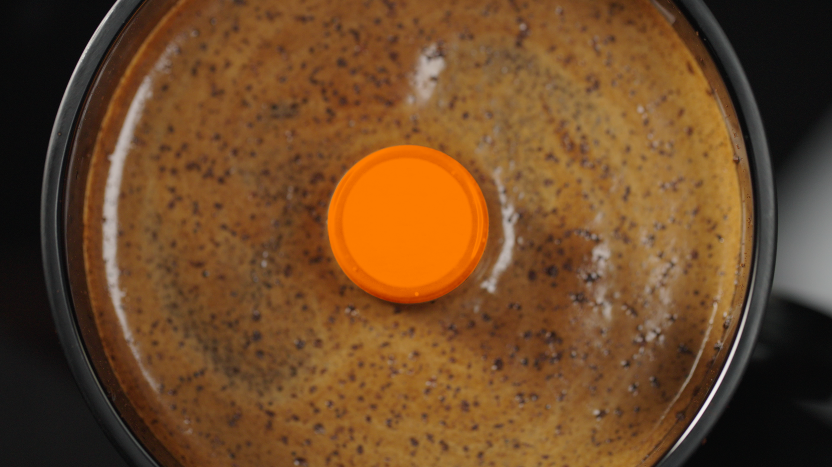
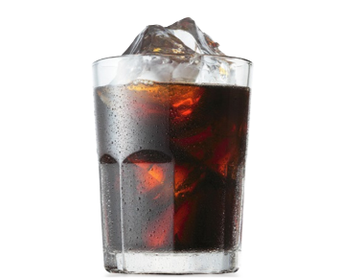
CT30000
VacBrew Starter Set
RRP US$129
Patented
design
Ice water for
Cold brew (5-12mins)
Vacuum
technology
<90C/203F water for
Hot brew (30s)
Type-C
Rechargeable
4 settings to tailor
For personal taste
Introducing VacBrew, the ultimate solution for coffee enthusiasts seeking both speed and flavor.
This innovative coffee maker utilizes advanced vacuum technology to deliver rich, hot and cold brew coffee in just one click.
Dual Brewing Capability:
VacBrew now offers the versatility to brew both hot and cold coffee, thanks to its enhanced chamber made from durable TRITAN material, capable of withstanding high temperatures.
Rapid Cold Brew:
Say goodbye to lengthy brewing times. VacBrew's patented TURTLE vacuum technology accelerates the extraction process, delivering smooth and flavorful cold brew coffee swiftly.
User-Friendly Design:
Engineered for simplicity, VacBrew is easy to use and clean, making it an ideal companion for home, office, or on-the-go brewing.
Portable and Durable:
Its compact design and robust construction ensure that you can enjoy your favorite coffee anywhere, anytime.
Experience the future of coffee brewing with VacBrew—a perfect blend of innovation and convenience, tailored for those who refuse to compromise on taste or time.
Package (GB)
LxWxH. 158x158x287mm
EAN Code.
Gross weight. kg
Net weight. kg
Carton
LxWxH. 494x329x309mm
EAN Code.
Gross weight. kg
Quantity
Per Carton. 6pcs
Per Pallet. pcs
Per Container 20ft. pcs
Per Container 40ft. pcs
Per Container 40HQ. pcs
104mm
81mm
Items included
Vacuum pump rechargeable w timer 1pc
Dual function Lid 1pc
Removable Filter SUS 500mesh per sq.in 1pc
Removable Deflector 1set
Brewing chamber 500ml 1pc
Glass jar 600ml 1pc
Stirrer 1pc
200mm
119mm
Idea from Spain
Solutions for your Home

Slide 5
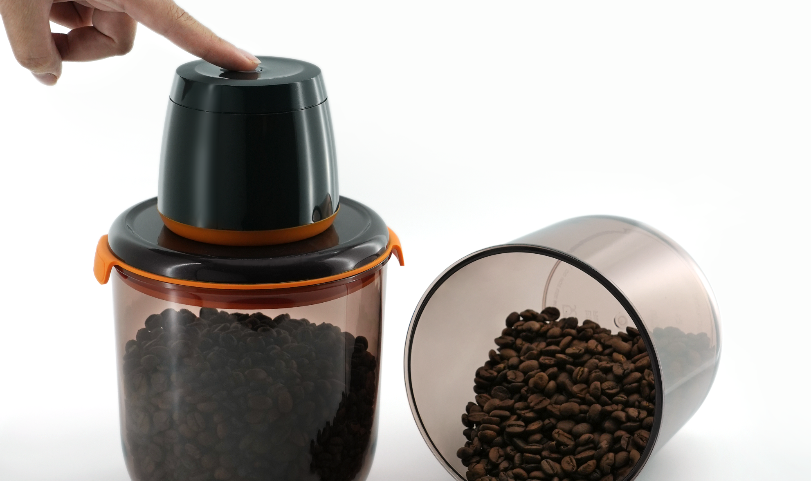
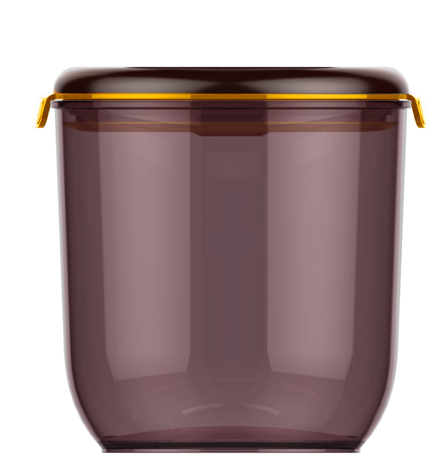

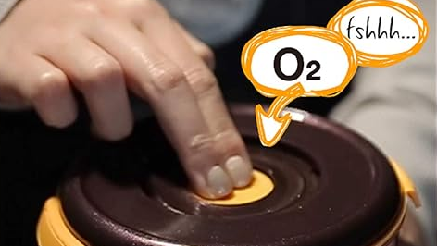



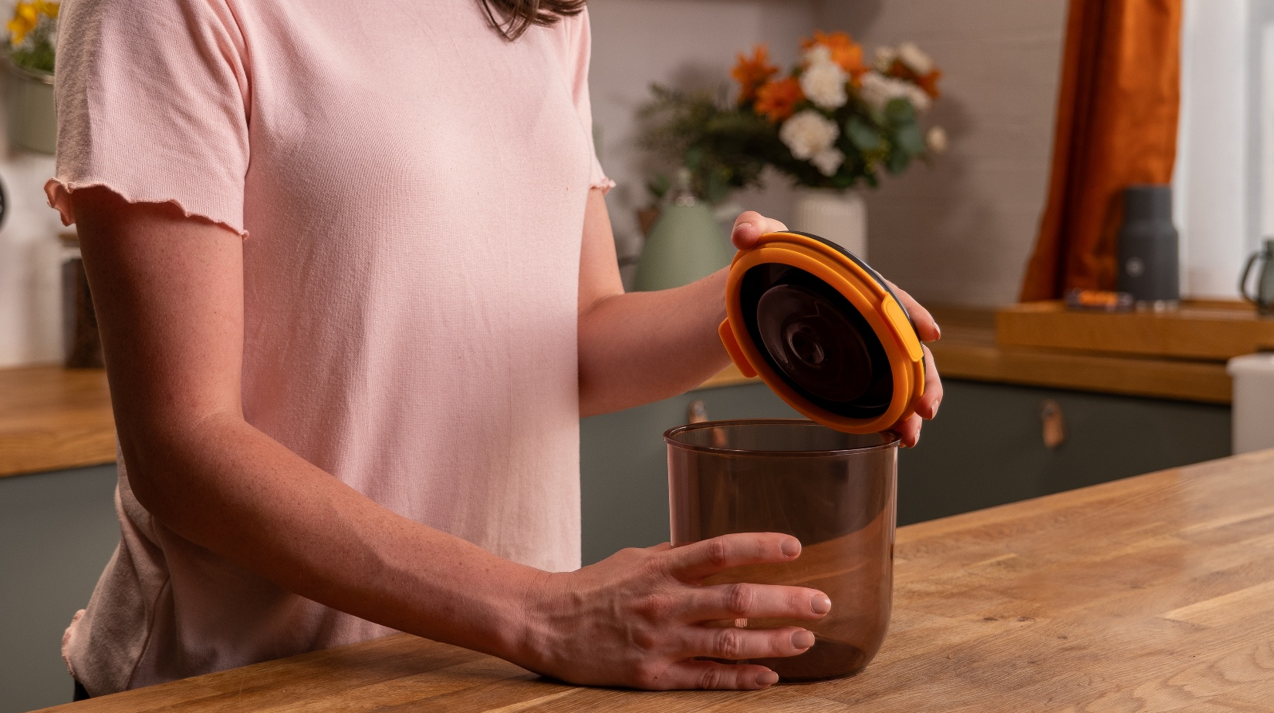
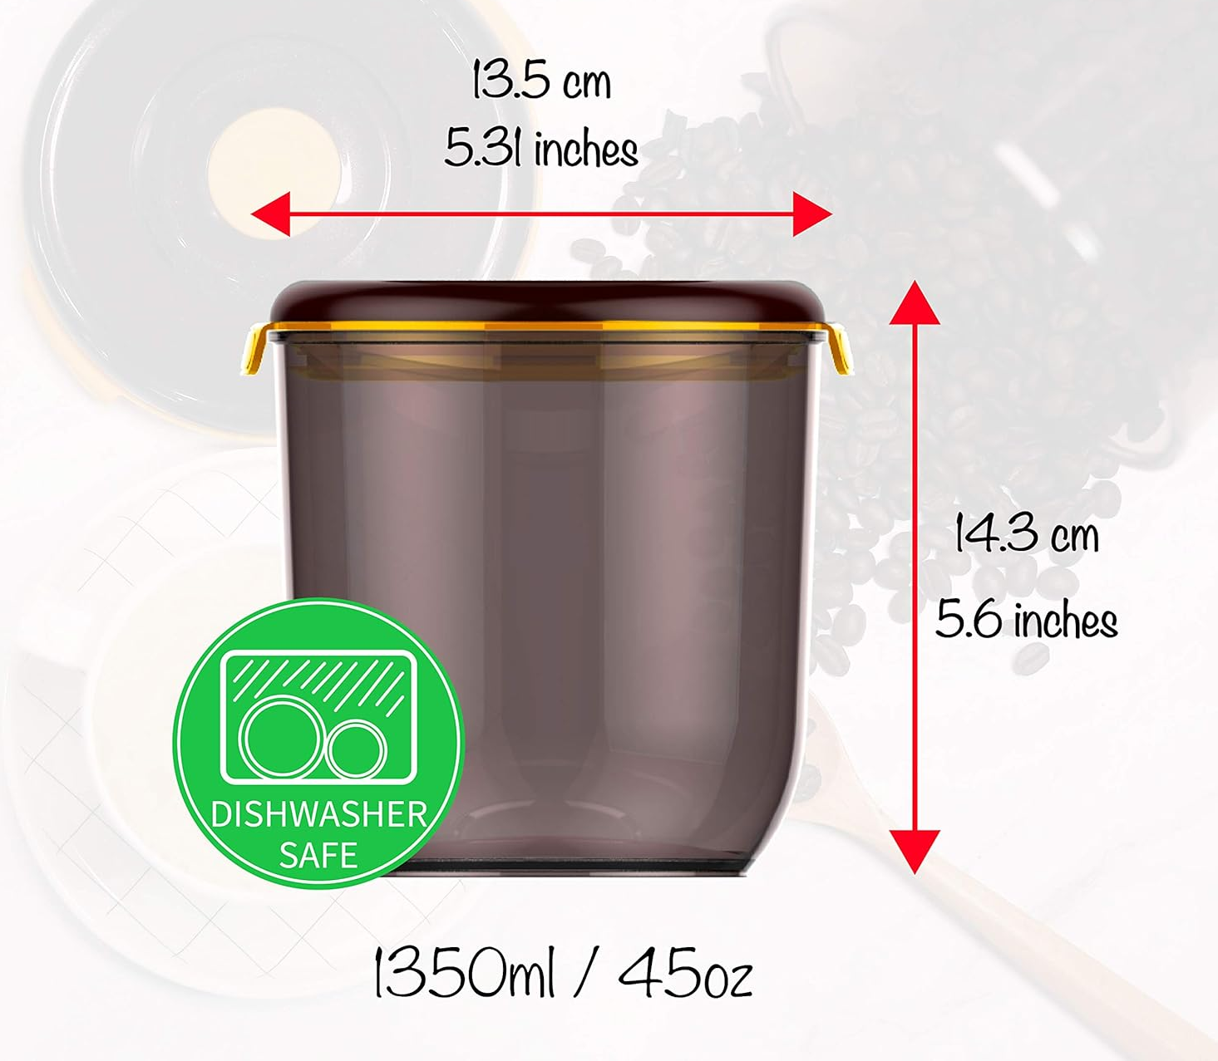
CT22700
UV-block Vacuum Canister 2pc set (PUMP not included)
RRP US$42
Patented
design
UV-block
Vacuum
technology
Keep coffee
Aroma & freshness
Dishwasher
safe
BPA Free
Preserve Freshness and Aroma with the UV-Block Vacuum Canister Set!!
For true coffee lovers, freshness is everything.
Our UV-Block Vacuum Canister 2pc Set, designed to complement the VacBrew range, ensures your coffee beans and ground coffee stay as fresh as the day you bought them.
Equipped with our advanced vacuum technology, these canisters use the same convenient Vacuum Turtle to remove air and moisture, locking in rich aromas and preserving flavor.
The UV-block design shields your coffee from harmful light, preventing deterioration and extending its shelf life.
Perfect for storing different varieties of beans or ground coffee, this set allows you to confidently explore and enjoy a wider range of flavors.
Whether you're brewing for yourself or hosting friends, you’ll always have the freshest coffee at your fingertips. Coffee lovers can now relax, store more, and savor every sip!
Package (GB)
LxWxH. 135x135x143mm
EAN Code. 8437015791678
Gross weight. kg
Net weight. kg
Carton
LxWxH. 478x470x340mm
EAN Code.
Gross weight. 9.16kg
Quantity
Per Carton. 9pcs
Per Pallet. pcs
Per Container 20ft. pcs
Per Container 40ft. pcs
Per Container 40HQ.pcs
Items included
UV-block Vacuum Canister 2pcs
Idea from Spain
Solutions for your Home

